Slide 1
SOCIAL & EMOTIONAL LEARNING
Social and emotional learning can improve positive attitudes towards self and others and increase students' academic perfomance.

Slide 2
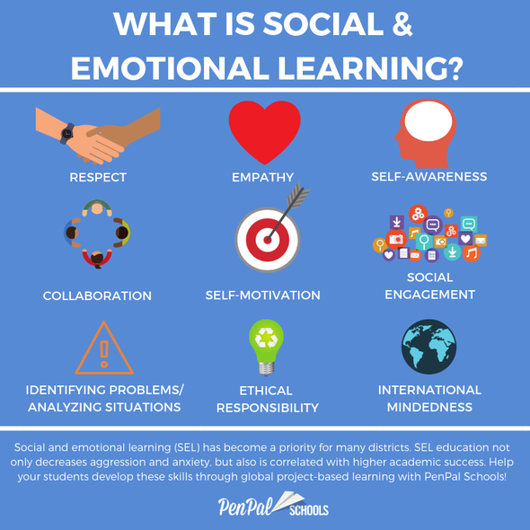

Slide 3
What is the purpose of SEL?
Social and emotional learning (SEL) is the process through which children and adults acquire and effectively apply the knowledge, attitudes, and skills necessary to understand and manage emotions, set and achieve positive goals, feel and show empathy for others, establish and maintain positive relationships, and make responsible decisions.

Slide 4
The Mississippi K-12 SEL standards are divided into five domains:
Domain 1: Self-awareness is the ability to identify one’s thoughts, values and emotions and recognize how these shape behaviors.
Domain 2: Self-management is the ability to self-regulate emotions, thoughts and behaviors across settings and to set and work towards personal and academic goals.
Domain 3: Social awareness is the ability to empathize with and relate to others, including those from diverse backgrounds.
Domain 4: Relationship skills include the ability to effectively communicate, cooperate, seek and provide support to others, manage conflict, and effectively handle peer pressure.
Domain 5: Decision-making skills includes the ability to make constructive choices and problem-solve based on safe, ethical, and social norms while evaluating the outcomes of previous choices.

Slide 5
Domain 1: Self- awareness
Self-awareness involves acknowledging who you are, your own personality, style, likes, wants, values, beliefs and future goals. To gain a better insight of who we are it is often helpful to self-reflect, and this involves taking time out to think about all these things. Everyone is different including in the way they communicate, learn, and process information or events which may happen.

Slide 6
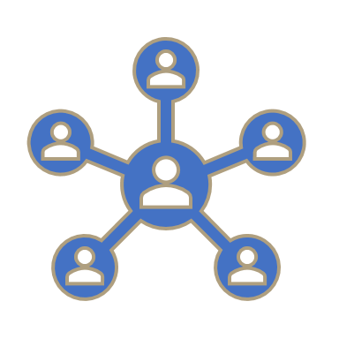
Why is self-awareness important?
Self-awareness allows us to understand our strengths and weakness, and therefore improve our weakness and use and acknowledge our strengths throughout day to day activities. The ability to understand our own strengths and weaknesses also promotes better decision making, and this in turn leads to more positive outcomes in life.

Slide 7
3 Ways to Improve Your Self-Awareness
1. Assess your self-talk and thoughts
2. Use your senses
3. Express your feelings

Slide 8
1. Assess your self-talk and thoughts
Listen to what your mind is saying, is it negative or positive: Listen to yourself. It is just like the saying "always looks on the bright side of life. If you have trouble sitting and thinking about yourself try writing down your thoughts or your feelings about how you look or feel, or another area of your life you may think about often.

Slide 9
2. Use your senses
Most of our insight into the world is gained through our senses, and in particular our eyes (sight) and nose (smell). These senses allow us to gain insight into our own worlds as well as the world of others such as family members or work colleagues. It is important that we don't let self-talk "filter" what we perceive in our world – it is important to often step back and objectively view things how they are. For example, someone groaning doesn't mean you're boring it may be that they have an issue on their mind that is frustrating or perhaps a simple stomachache – it is important to be aware of other interpretations and not always jump to the conclusion offered by our first thought.

Slide 10
3. Express your feelings
Many people do not like to think too much about their feelings, and this may make getting any emotions out very difficult for them; however doing so can often be very worthwhile. Our feelings are immediate responses to our experiences and give us good information about what is happening in a situation.

Slide 12
Lesson/Activity: Self Awareness
Ask students to identify their own personal strengths and weaknesses that they’d like to work on through art illustration or essay form.

